Slide 1
Burrows-Wheeler Transform ​
and its applications towards ​
genome assembly​
​
​
Done By
K. Vinayak (CB.EN.U4AIE19032)​
M. Gnanadeep (CB.EN.U4AIE19041)​
Prashanth VR (CB.EN.U4AIE19047)​
V. Bindu Sri (CB.EN.U4AIE19069)​
​

Slide 2
WORK SPLIT-UP
M. Gnanadeep (CB.EN.U4AIE19041)​ | Theory - Research on Implementation of BWT (using Python)
Prashanth VR (CB.EN.U4AIE19047)​ | Theory & Implementation of BWT using Suffix Array, Compression and Decompression methods (using Julia)
K. Vinayak (CB.EN.U4AIE19032)​ | Theory - Inverse BWT And Applications (using Java)
V. Bindu Sri (CB.EN.U4AIE19069)​ | Theory - Research on Pattern Match and Challenges (using Javascript & R)

Slide 3
INTRODUCTION ​
The Burrows-Wheeler Transform (BWT) or block sorting compression idea was started by David Wheeler in his unpublished paper in 1983 and later it was modified by Michael Burrows along with the founder in 1994 at DEC Systems Research Center in Palo Alto, California. ​
In this report we are going to present BWT implementation using Move to Front Transform, Suffix Array methods in detail. Since BWT is easy to implement it has got many applications in medical fields like storing DNA like large sequences, pattern matching using FM indexing, and in other fields where large data is stored using compression methods.​

Slide 4
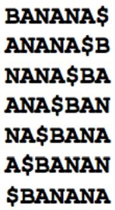
BWT USING MOVE TO FRONT TRANSFORM​
Let S be the original string, we rotate the string S ‘n’ times in clockwise direction i.e. we move the last character in the string to the first place, where ‘n’ corresponds to the length of the string S and we store the rotated strings in a matrix called BWT matrix.​ ​
Let the string S be ‘BANANA’ and let’s take ‘$’ as the reference symbol to denote the end of string. So, if the ‘$’ appears at the start of the string then we can confirm that the rotation got completed.​

Slide 5
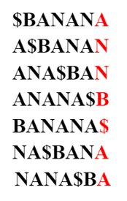

Lexicographically arranged order of the BWT matrix is shown beside. The last column is the rearranged sequence of the original string which has least entropy among all the columns in BWT matrix. ​
This column helps us to retrieve the original string without any additional information(except the index where the sequence occurred in the BWT matrix). So, we can conclude BWT as one of the best methods to store or retrieve the information without any additional cost.​

Slide 6
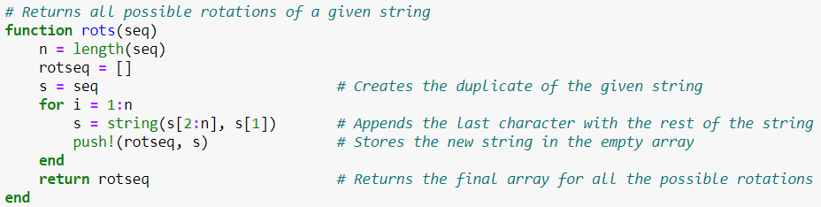
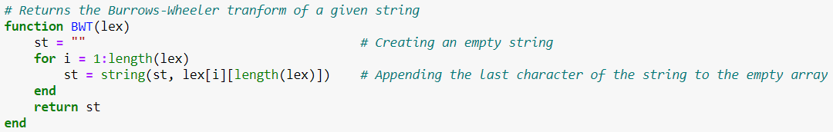
IMPLEMENTATION OF BWT IN JULIA

Slide 7
SUFFIX ARRAY​
Suffix array is a data structure which is a sorted array of all the suffixes obtained from a given text or a string and usually used in full string indices and data compression algorithms.
This can be used as an index for quickly locating an occurrence of a pattern or a substring given the parent string. ​So, finding the occurrence of a pattern is the same as finding all the suffixes that begin with the substring.
​
This algorithm is very efficient in computing Burrows-Wheeler transform (BWT). This involves sorting cyclic permutations of a string and can be computed in linear time by first constructing a suffix array and then extracting the BWT sequence from it. The method used above to build suffix array which has O(n^2Logn) time complexity, due to O(n) time for strings comparisons in O(nLogn) sorting algorithm.

Slide 8
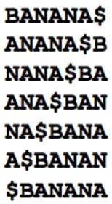
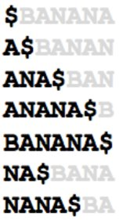
IMPLEMENTING BWT USING SUFFIX ARRAYS
First, we should store all the cyclic permutations of a given string and store them in an array. Here in this scenario, let us consider a standard example string “BANANA$”.​
Next sort them in lexicographical order and figure out all the suffixes for all the possible permutations.​

Slide 9
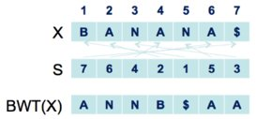
Generally, Suffix array S is just an array containing indices, where S[i] contains the index of the ith smallest suffix occurring in the parent string “BANANA$”. For example, S[1] contains the index of the 1st smallest suffix ie, “$” occurring in the string “BANANA$”. This index corresponds to the last index of the original string which is 7.​
Constructing a BWT sequence from the given Suffix array is as simple as we could imagine. First, we will go to the character of the original sequence indicated by the index S[i] and then move one spot to the left of the indicated index.​

Slide 10
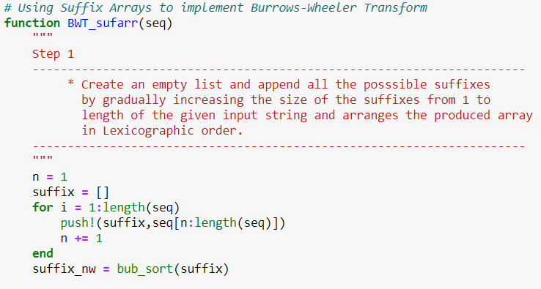
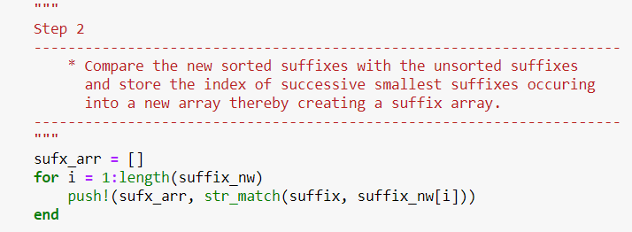
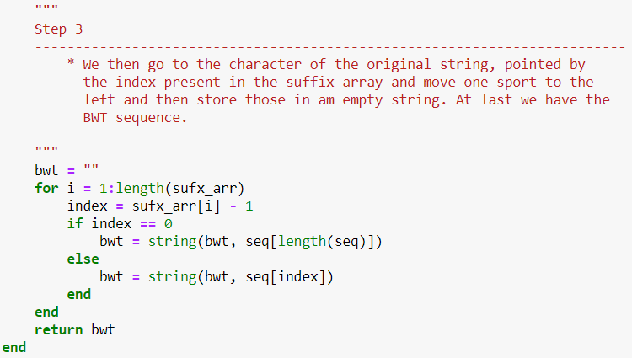

Slide 11


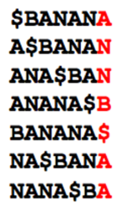
INVERSE BURROWS-WHEELER TRANSFORM
We append BWT to an empty array as the last column of the array.
Then we sort the column.
We do this for n times, where n is length of String
After 1st iteration
After 2nd iteration
After 'n' iteration

Slide 12
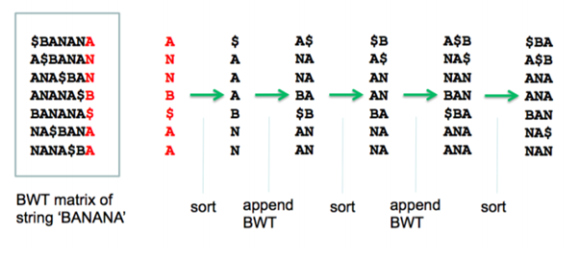

Slide 13
IMPLEMENTATION OF INVERSE BWT IN JULIA

Slide 14
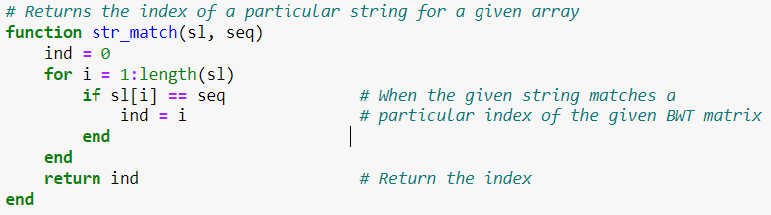
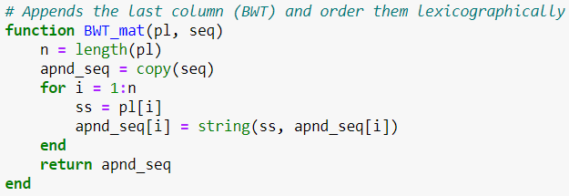
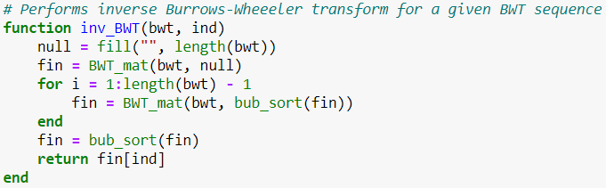

Slide 15
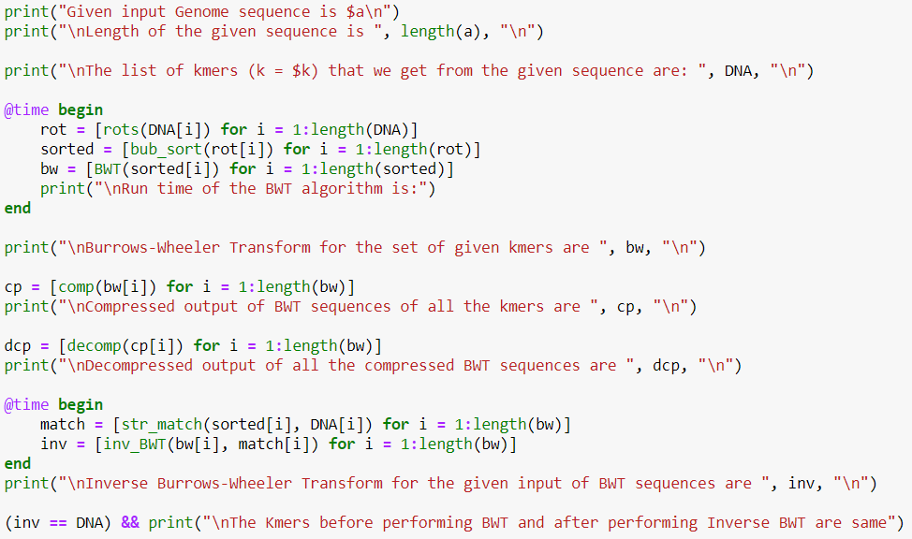
EXPERIMENTING IN JULIA

Slide 16
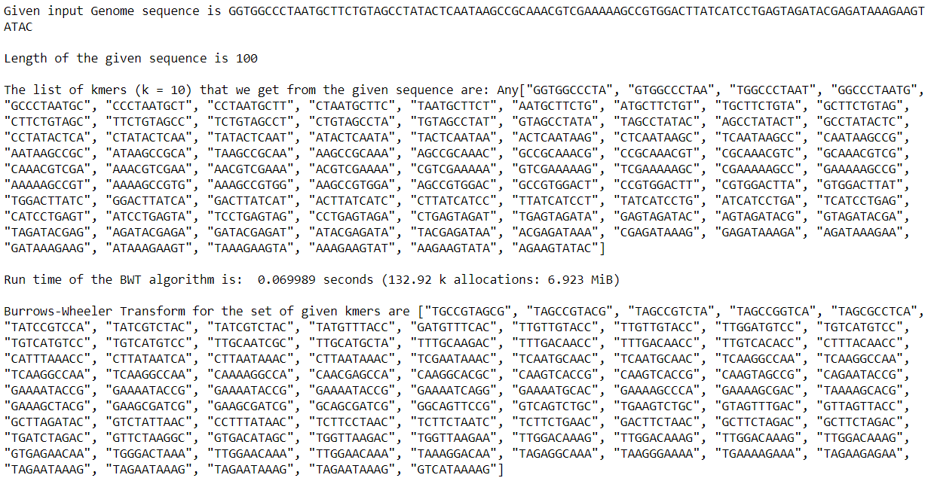

Slide 17
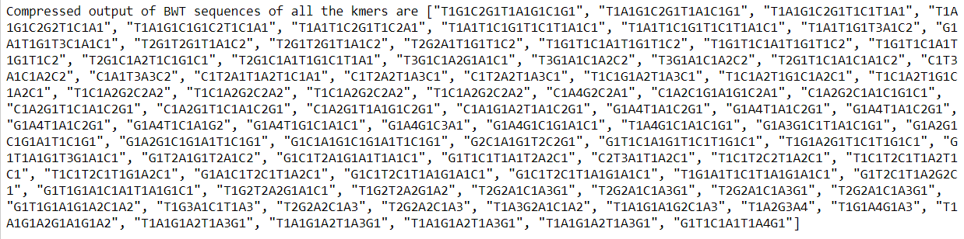
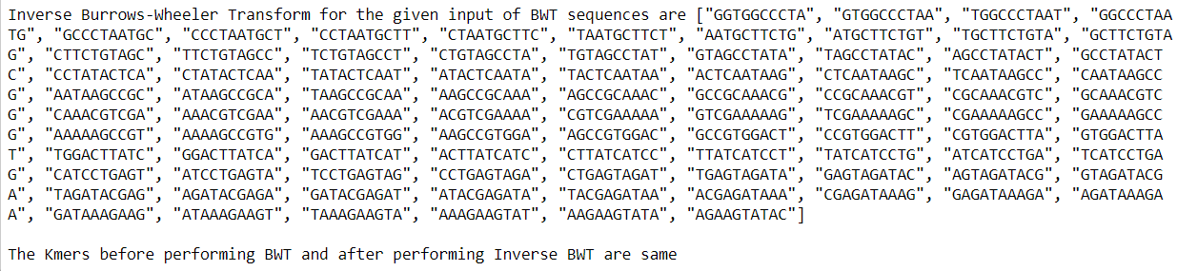

Slide 18
APPLICATIONS OF BURROWS-WHEELER TRANSFORM

Slide 19
K-MER FINDING​
K-mer refers to a string of length ‘k’ generally in DNA sequences. Here we are trying to optimise time by using BWT to find K-mers. There are many methods to find K-mers in the genome like Brute Force, Suffix Array, Suffix Tree, But this BWT is employed for reducing time and complexity.​
​
To know about BWT EXACT MATCH firstly we should be aware of FM-index, Offset array, Predecessor Suffix. Let’s look at these in detail. ​

Slide 20
FM INDEX​
FM index stands for Full-text index in Minute space and was created by Paolo Ferragina and Giovanni Manzini to minimise time complexity in generating substrings. It is basically a compressed full-text substring index known to compress the input text and creates substring queries in no time.
In general FM-index denotes the number of times a symbol occured before the given position.
● N denotes the text length
● F[i][c] stores the number of times symbol ‘c’ occurs before index i

Slide 21
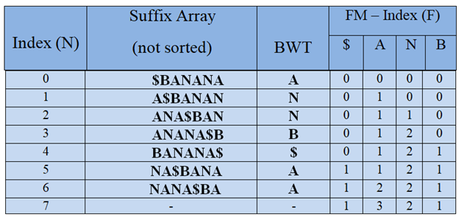
The FM-index of string ‘ $BANANA’ is as follows

Slide 22
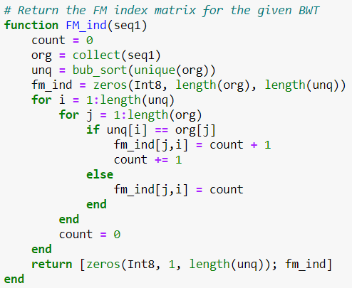
IMPLEMENTATION OF FM-INDEX IN JULIA

Slide 23
OFFSET ARRAY
Offset generally means the number of previous elements to cross to reach the current element. It is the same here to compute the number of previous elements.
Offset array is indicated with the letter O. O[c] stores the index of the first suffix starting with symbol c. It can be computed in two ways using the FM-index matrix that we created before or directly from the BWT string. We’ll discuss these two methods in detail.

Slide 24
● Offset Array using FM-index
It can be derived directly from the final entry in F i.e.
$ A B N
F[lastRow] 1 3 2 1
O[B] = sum(F[lastRow][$:B]) =1+3 = 4

Slide 25

● Offset Array using BWT(string)
BWT(BANANA$) = ANNB$AA
Arrange it in lexicographic order ; $AAABNN
Indices -
$AAABNN
0 1 2 3 4 5 6
Get the first occurence of each symbol -

Slide 26
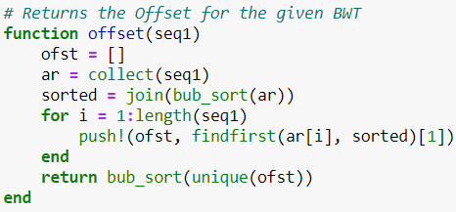
IMPLEMENTATION OF OFFSET IN JULIA

Slide 27
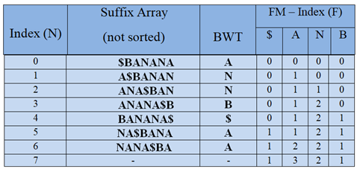

Predecessor Suffix
Given an index i in the BWT, find the index in the BWT of the suffix preceding the suffix represented by i
● The predecessor suffix of index i
c = BWT[i]
predec = O[c]+F[i][c]
Predecessor of index 1
c = BWT[1] = ‘N’
predec = O[‘N’]+F[1][‘N’] = 5+0 = 5
● Time to find predecessor: O(1)

Slide 28
Find K-mer
● All searches occur in reverse order
● Start with full BWT range (0, N)
● Restrict by one symbol at a time
● Does not depend on BWT (data) size
Let’s look at an example of k-mer “AN”
Initializing to full range
low = 0
high = 7
Find occurrences of “N”
Updating low & high each time we iterate
low = O[‘N’]+F[low][‘N’] = 5+0 = 5
high = O[‘N’]+F[high][‘N’] = 5+2 = 7
Find occurrences of “AN”
low = O[‘A’]+F[low][‘A’] = 1+0 = 1
high = O[‘A’]+F[high][‘A’] = 1+3 = 4

Slide 29
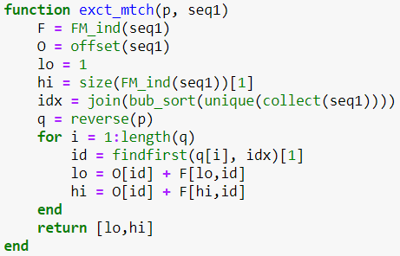
IMPLEMENTATION OF EXACT PATTERN MATCHING IN JULIA

Slide 30
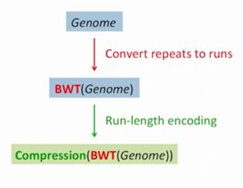
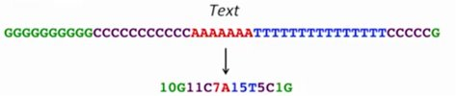
ROLE OF BWT IN COMPRESSION​
BWT is a method used for storing information as it has the capability to decrease the randomness and to form runs in the string.
Example of how BWT is used in compression of DNA sequences.​

Slide 31
IMPLEMENTATION OF BWT USING SUFFIX ARRAYS APPROACH IN JULIA

Slide 32
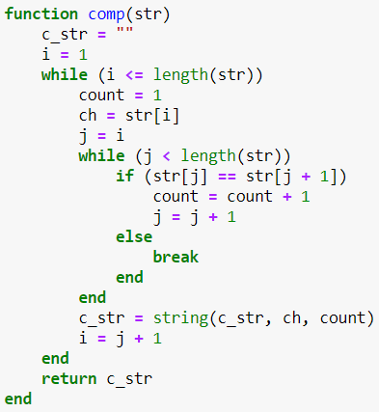
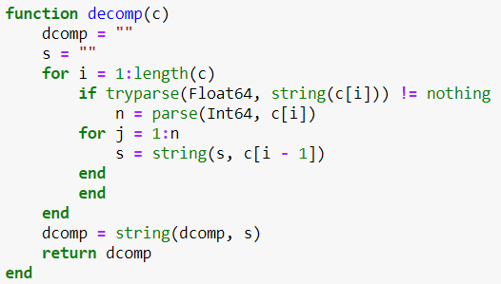

Slide 33
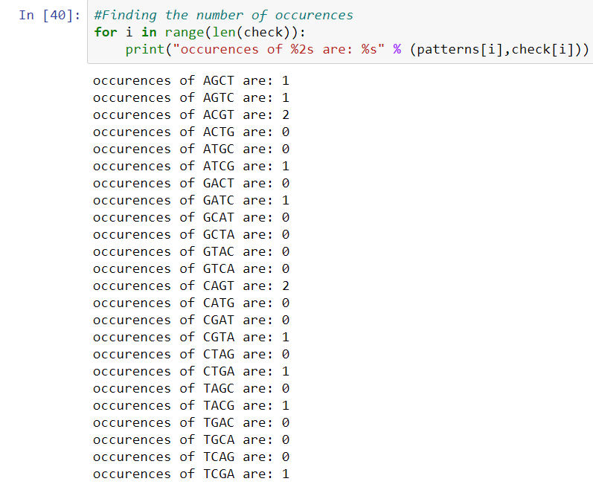
Pattern Counting:
Here we will find the number of occurrences of the pattern using BWT string of a given sequence and a pattern.
This represents the occurrences of different patterns according to the sequence we took above:

Slide 34
TIME COMPLEXITY IN DIFFERENT LANGUAGES
Language | Time Taken for BWT | Time Taken for IBWT
Julia | 0.070155 s | 0.053870 s
Javascript | 0.048ms | 8.827ms
Python | 0.932507 s | 0.001993 s
R | 0.05 s | 0.12 s
Java | 0.00238s | 0.3076098 s
**K - mer of length 100

Slide 35
CHALLENGES IN GENOME ASSEMBLY USING BWT
Genome assembly is a widely concerned area in bioinformatics where we are given large lengthened reeds and asked to find the original DNA sequence. DNA is about a million to trillion lengthened sequence since it is impossible to fit that entire sequence in computers while dealing with its properties. We split it into multiple reeds and work on them.
BWT is used when we are familiar with the original sequence and want to find it’s permutation string i.e. the string with more information and least entropy. Using this BWT string we can find the original genome sequence with no extra information except the index where the original string occurred in the BWT matrix.

Slide 36
So it is necessary for us to be familiar with the original genome sequence while working with BWT. But in the real world scenario we won’t be knowing the original DNA sequence in prior. This is the main challenge faced in genome assembly.
Generally we will perform a prefix suffix match to arrive at the original sequence from the given reeds by using string reconstruction methods like Hamiltonian, Eulerian walks and debruijn path. In BWT we can’t perform prefix suffix match. So this is going to be one more challenge in genome assembly approach using BWT.

Slide 37
IMPLEMENTATION IN PYTHON

Slide 38
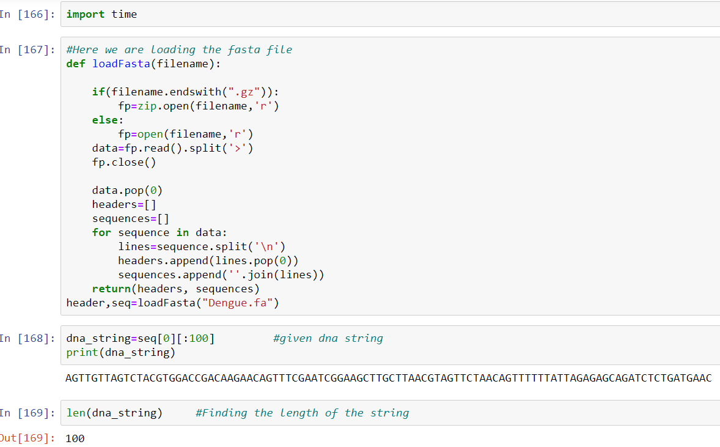

Slide 39
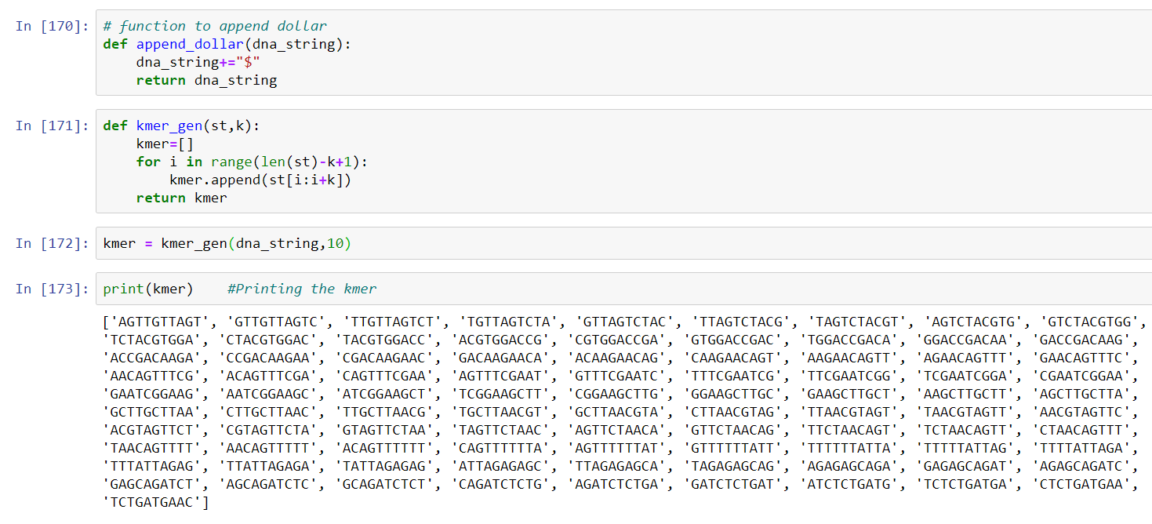

Slide 40
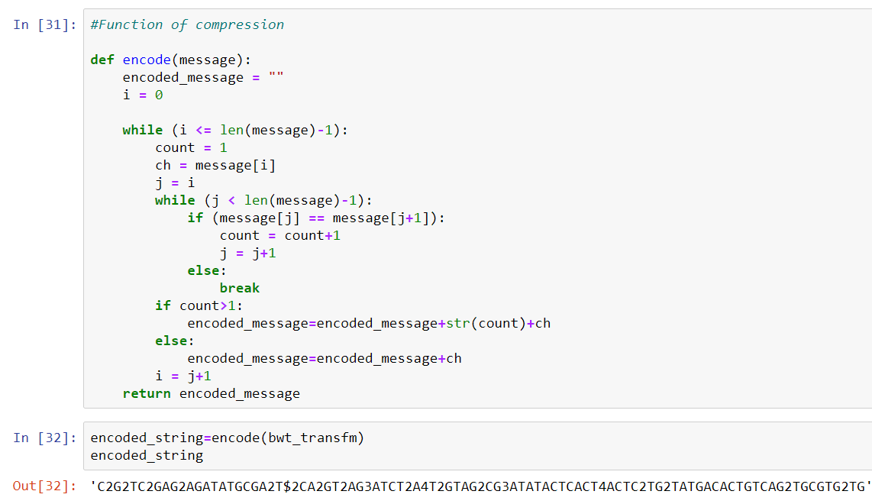
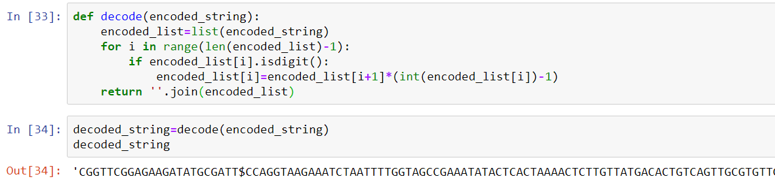
Encoding & Decoding:

Slide 41
IMPLEMENTATION IN JAVASCRIPT

Slide 42
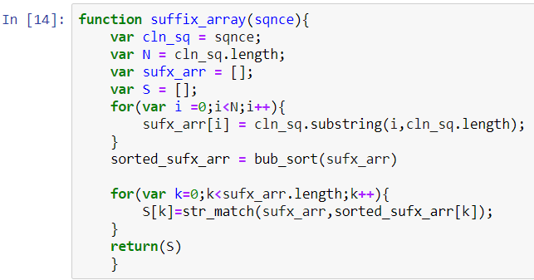
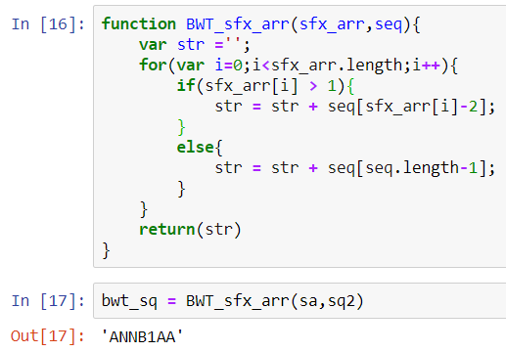
BWT SUFFIX ARRAY

Slide 43
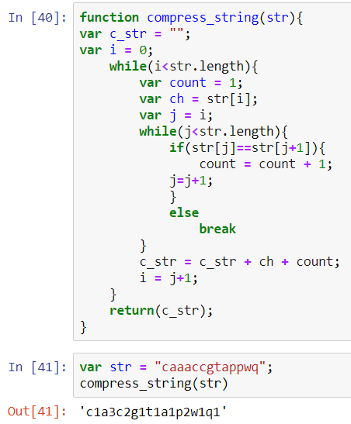
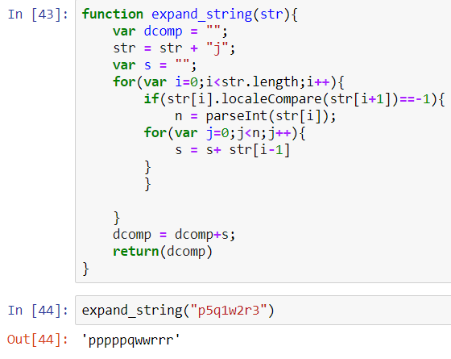
Compression And Decompression

Slide 44
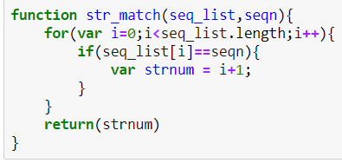
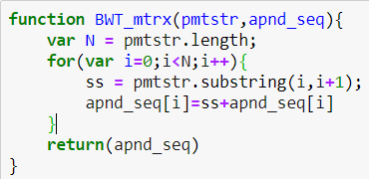
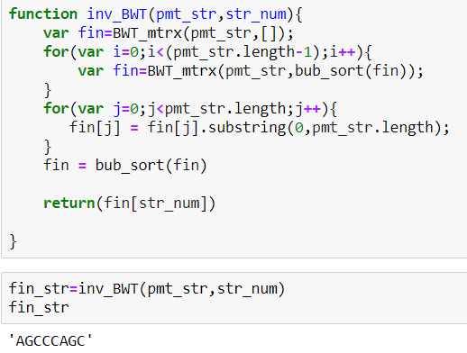
INVERSE BWT

Slide 45
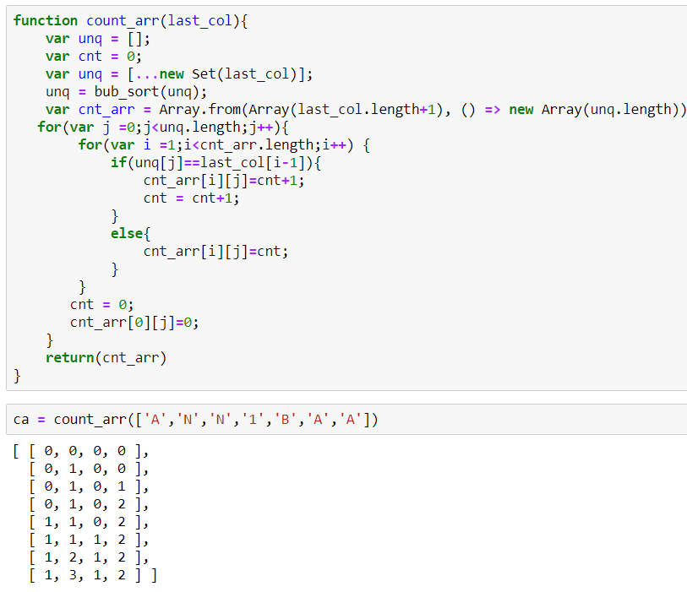
FM INDEX

Slide 46
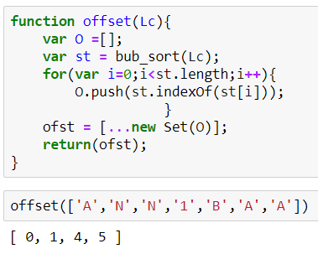
OFFSET ARRAY

Slide 47
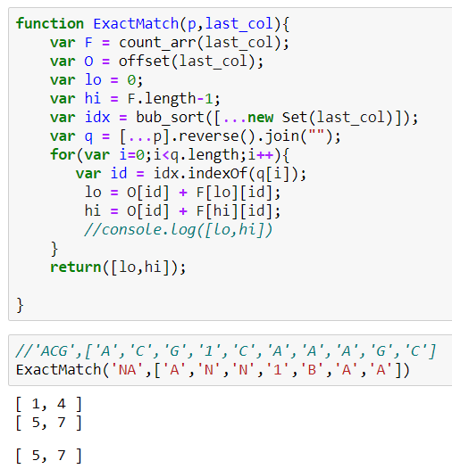
EXACT PATTERN MATCH

Slide 48
IMPLEMENTATION IN JAVA

Slide 49
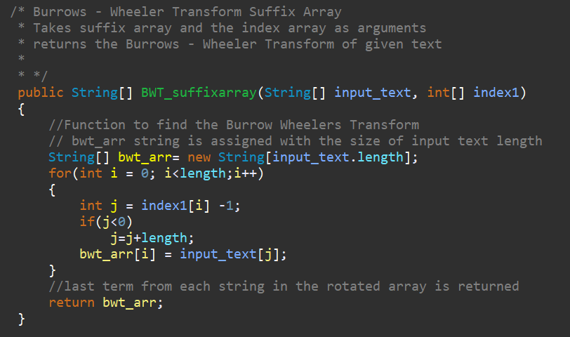
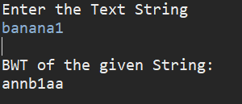
BWT SUFFIX ARRAY
OUTPUT

Slide 50
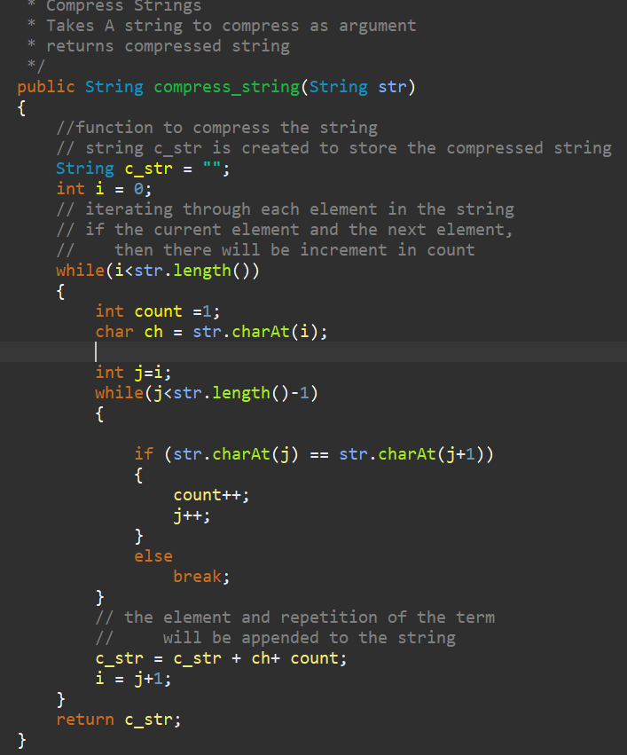
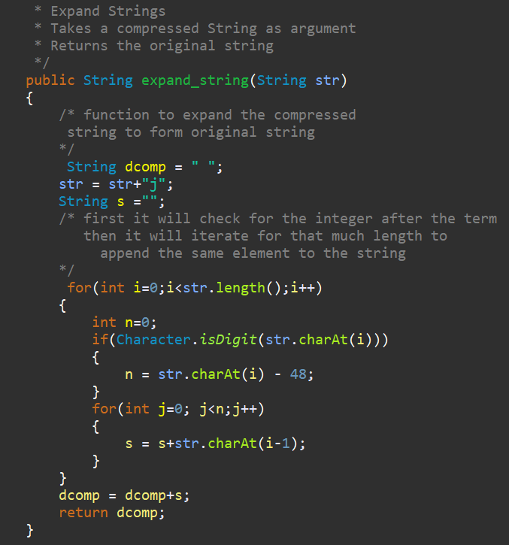
Compression And Decompression

Slide 51
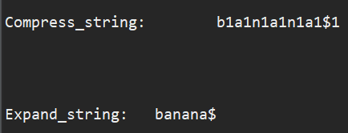
OUTPUT

Slide 52
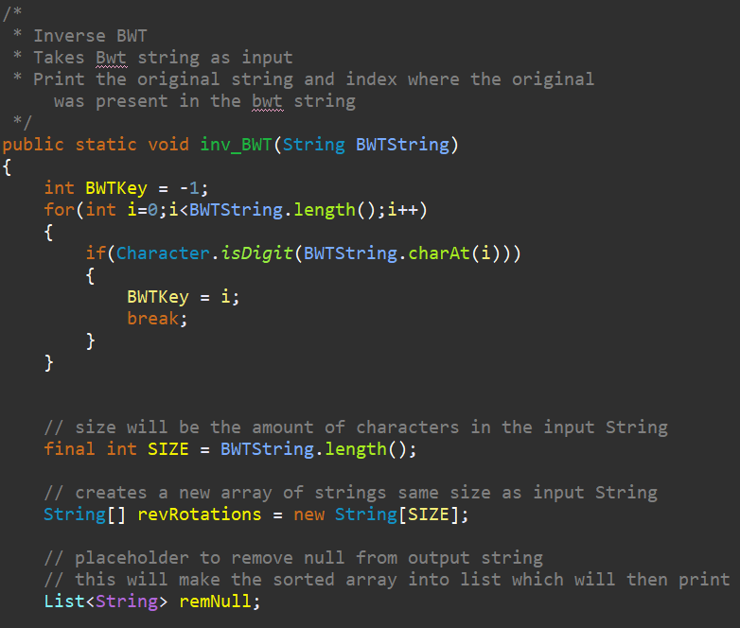
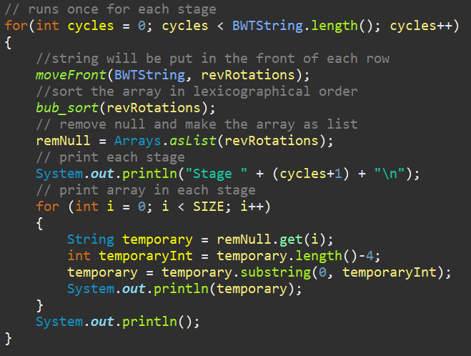
INVERSE BWT

Slide 53


Slide 54



OUTPUT

Slide 55

FM INDEX

Slide 56


OUTPUT

Slide 57


OFFSET ARRAY
OUTPUT

Slide 58

EXACT PATTERN
MATCH

Slide 59


Slide 60
IMPLEMENTATION IN R

Slide 61


Slide 62



Slide 63


